Slide 1
Introduction to Excel
Part Two

Slide 2
Objectives
Types of Data (Numbers, Text, Date)
Planning a workbook
Workbook Structure
Microsoft Excel Shortcuts as per Microsoft Help

Slide 3
Microsoft Excel
Computer program used to enter, store, analyze, and present data in an organized and easily updatable manner
Creates electronic versions of spreadsheets which are a collection of numbers and text laid out in a grid
Displays values calculated from data
Represents data in both text and graphical form through the use of charts

Slide 4
Types of Data: Text, Numbers, and Dates
Text data (Qualitative Data)
Combination of letters, numbers, and symbols. Anything other than numbers.
Often referred to as a text string
Number data (Quantitative Data)
Numerical value to be used in a mathematical calculation
Can be part of a formula or calculation
Date and time data
Commonly recognized formats for date and time values
Can be part of a formula or calculation

Slide 5
Planning a Workbook
Define:
Goal or purpose of workbook
Type of data to collect
Formulas needed to apply to data you collected and entered
Appearance of workbook content
Appearance of results – tables and graphs

Slide 6
Workbook Structure
A workbook can have several kinds of worksheets, for example:
Data
Analysis
Chart
Presentation

Slide 7
Creating a New Workbook
Open the File tab (Backstage View) on the ribbon
Click the new tab
Select the Blank Workbook option. Notice there are many templates available to you.

Slide 8
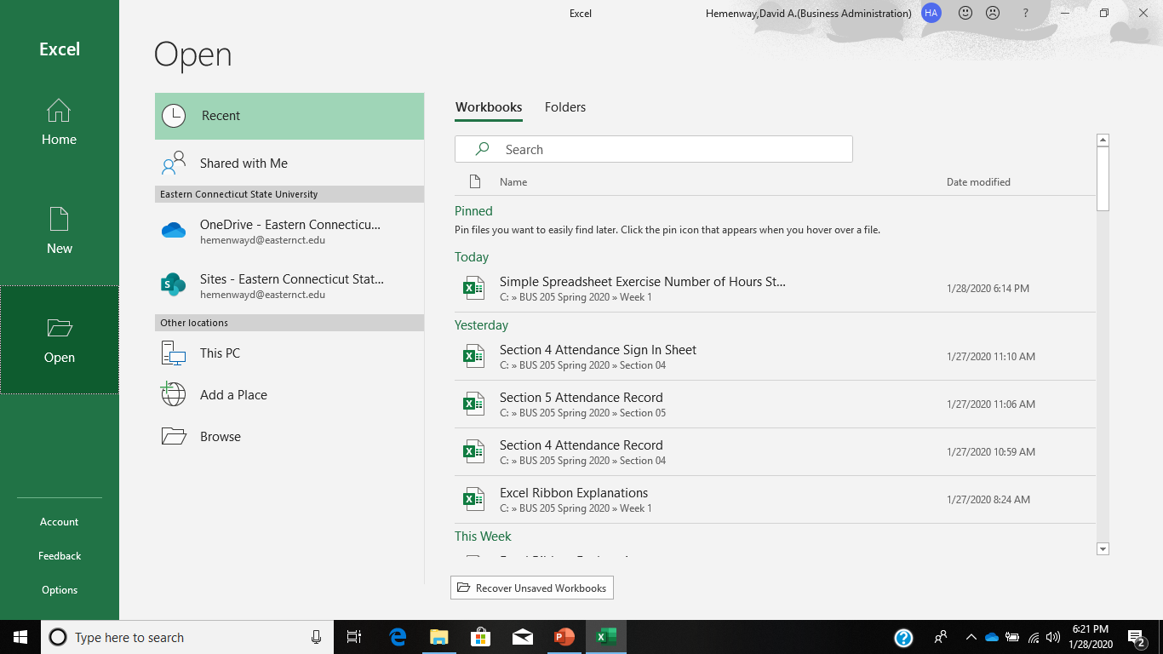
Opening a spreadsheet

Slide 9
Working with Worksheets
Inserting a worksheet
Name new worksheet
Deleting a worksheet
Highlight worksheet and press delete
Renaming a worksheet
31 characters maximum, including blank spaces
Width of sheet tab adjusts to length of name

Slide 10
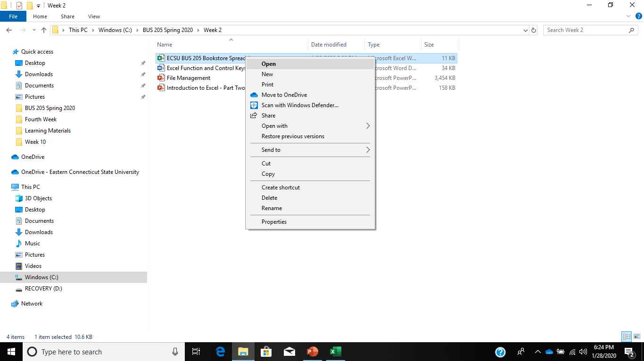
Working in File Manager

Slide 11
Microsoft Excel Shortcuts as per Microsoft Help
https://support.office.com/en-us/article/keyboard-shortcuts-in-excel-1798d9d5-842a-42b8-9c99-9b7213f0040f
See: Excel Function and Control Keys document in the Week 2 folder on Blackboard

Slide 12
Mathematical Symbols
Operation | Common Symbol | Symbol in Excel
Addition | + | +
Subtraction | - | -
Multiplication | X | *
Division | ÷ | /
Exponentiation | ^ | ^
Notes:
See Table 1.4 for a list of mathematical operators.

Slide 13
Create this spreadsheet using appropriate formulas and in the shown format
Number of Hours Studying for BIS 205 Per Week
 | Average
Hours | Number | Percent
0 | 5 | 14%
1 | 3 | 9%
2 | 2 | 6%
3 | 5 | 14%
4 | 7 | 20%
5 | 6 | 17%
6 | 3 | 9%
7 | 2 | 6%
8 | 1 | 3%
9 | 1 | 3%
> 10 | 0 | 0%
Total | 35 | 100%
Source: DH made-up data
Author:
File:

